Slide 1
Metro Energy Optimization through Rescheduling: Mathematical Model and Heuristics Compared to MILP and CMA-ES
David FOURNIER, PhD CIFRE Inria/GE Transporation, 3rd year
CWM3EO BUDAPEST
SEPTEMBER 26TH 2014

Slide 2
Context
Use of regenerative braking
Metro lines without energy storage devices
Key industrial problem and differentiator for GE
Notes:
Industrial problem, expliquer que GE a ça comme problème réel. Ajouter un slide sur nos actions (classification + heuristique). Pourquoi heuristique ?
Why did GE pay for me ?

Slide 3
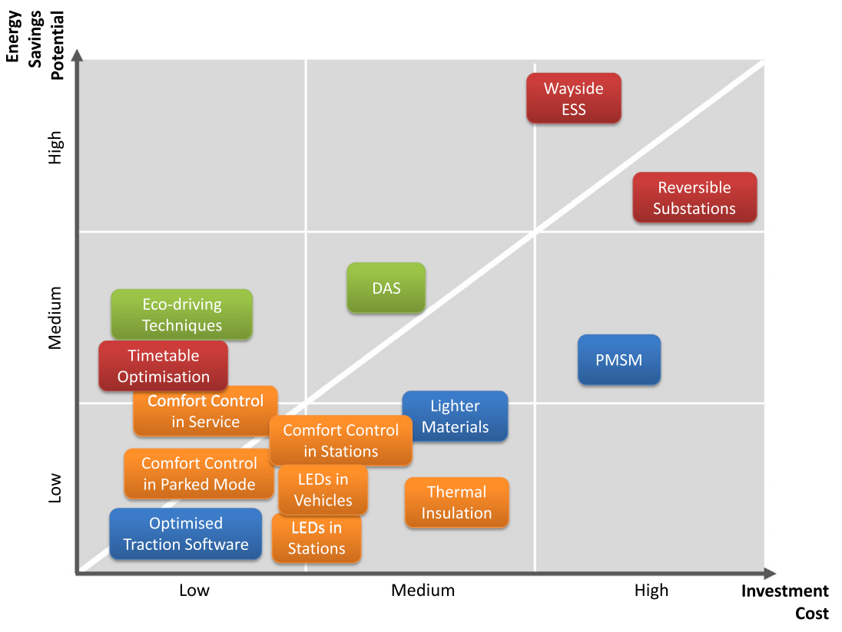
Energy Saving Techniques
Gonzales et al. « A systems approach to reduce urban rail energy consumption », Energy Consumption and Management vol. 80 2014
Notes:
Industrial problem, expliquer que GE a ça comme problème réel. Ajouter un slide sur nos actions (classification + heuristique). Pourquoi heuristique ?
Why did GE pay for me ?

Slide 4
Energy Saving Techniques
Best investment cost / energy saving potential ratio
Gonzales et al. « A systems approach to reduce urban rail energy consumption », Energy Consumption and Management vol. 80 2014
Notes:
Industrial problem, expliquer que GE a ça comme problème réel. Ajouter un slide sur nos actions (classification + heuristique). Pourquoi heuristique ?
Why did GE pay for me ?

Slide 5
Braking and Acceleration Phases
Powerful accelerations after departing a station
Powerful braking before arriving to a station
Traction Energy
Regenerative Energy
Station A
Station B
Time slot 1
Time slot 2
Time slot 3
Time slot 4
Coasting
Accelerating
Braking
Notes:
Speed profiles fixés, on néglige les accelerations et freinages intermédiaires. Donc approximation par intervalles.

Slide 6
Trains synchronization
A
B
A
B
Power
time

Slide 7
Our contribution
Classification of energy optimization timetabling problems
Fast and accurate approximation of the instant power demand
Conception, implementation and comparison of a dedicated heuristic for the problem
Notes:
Industrial problem, expliquer que GE a ça comme problème réel. Ajouter un slide sur nos actions (classification + heuristique). Pourquoi heuristique ?
Why did GE pay for me ?

Slide 8
Timetable Classification

Slide 9
Timetable problems classification
{Objective function,
Decision variables,
Global consumption G
Power peaks PP
Instant power
Evaluation}
Departure times dep
Dwell times dwe
Interstation times int
Simulator sim
Linear approx. lin
Non linear approx. nonlin
Notes:
Pourquoi une classification ? Même un problème précis a des variantes.

Slide 10
Timetable problems classification
Authors | Class | Article
Albrecht | (PP, dwe-int, sim) | Reducing power peaks and energy consumption in rail transit systems by simultaneous metro running time control
Sanso et al. | (PP, dwe, sim) | Trains scheduling desynchronization and power peak optimization in a subway system
Kim et al. | (PP, dep, lin) | A model and approaches for synchronized energy saving in timetabling
Miyatake and Ko | (G, dep-int, sim) | Numerical analyses of minimum energy operation of multiple trains under DC power feeding circuit
Peña et al. | (G, dep-dwe, lin) | Optimal underground timetable design based on power flow for maximizing the use of regenerative-braking energy
Nasri et al. | (G, dwe, sim) | Timetable optimization for maximum usage of regenerative energy of braking in electrical railways systems
Fournier et al. | (G, dwe, nonlin) | A Greedy Heuristic for Optimizing Metro Regenerative Energy Usage
Notes:
Jouer sur les couleurs et pas sur les contrastes

Slide 11
Tackling (G,dwe,nonlin)
G: Global energy consumption minimization
dwe: Dwell times modifications, rest fixed
nonlin: Power flow based objective function
+10000 variables
Non-linear objective function
No dedicated algorithm
Notes:
Remonter le point 2 sur le transparent précédent

Slide 12
Instant Power Demand

Slide 13
The objective function G
Bottleneck of the optimization
Arithmetic sum of the instant power demands computed with a power flow at each time interval
$P_{20}$: instant power demand of time step 20
$$G=\sum_{i}^{Time steps}{P_{i}}$$
0 15 30 45 60 75 90 105 120 135 150 165 180 195 210 225 240 255 270 285 300 315

Slide 14
Instant Power Demand
Joule effects in the third rail
Non linear electricity equations
How to evaluate the transfer of energy between metros and the total amount of energy flowing through the electric substations ?

Slide 15
Metro Line Model
S1
S2
S3
S4
S5
S6
S7
Electric points being:
Metro platforms
Electric substations

Slide 16
Metro Line Model
S1
S2
S3
S4
S5
S6
S7
ESS1
ESS2
ESS3
ESS4
ESS5
ESS6
1500V
1500V
1500V
1500V
1500V
1500V
R₁
R₂
R₃
R₄
R₅
R₆
R₇
R₈
R₉
Electric substations are represented by a voltage source. Metro platforms by an electrical potential point.

Slide 17
Metro Line Model
Trains accelerate or brake near a metro platform.
They consume or produce power.
S1
S2
S3
S4
S5
S6
S7
ESS1
ESS2
ESS3
ESS4
ESS5
ESS6
1500V
1500V
1500V
1500V
1500V
1500V
R₁
R₂
R₃
R₄
R₅
R₆
R₇
R₈
R₉
P_{acc}=1.5MW
P_{brk}=0.5MW
Each time step, a set of braking and accelerating metros run on the line.

Slide 18
Known Parameters
Voltages in Electric Substations
Power produced/consumed by trains
Resistances between points in line
Unknown Variables
Voltages in every electric points
Intensity flowing through the circuit

Slide 19
Instant power demand
S1
S2
S3
S4
S5
S6
S7
ESS1
ESS2
ESS3
ESS4
ESS5
ESS6
1500V
1500V
1500V
1500V
1500V
1500V
R₁
R₂
R₃
R₄
R₅
R₆
R₇
R₈
R₉
P_{acc}=1.5MW
P_{brk}=0.5MW
Solving electricity equations gives voltages and intensities
Non revertible electric substations
Total power demand: $P\left(total\right)=P_{{ESS}_{1}}+P_{{ESS}_{2}}+P_{{ESS}_{3}}+P_{{ESS}_{6}}$

Slide 20
Distribution matrix
Electric simulation accurate but slow.
Computation of the power ratio a braking metro will transfer to an accelerating metro between each pair of stations of the line.
S1
S2
S3
S4
S5
S6
S7
ESS1
ESS2
ESS3
ESS4
ESS5
ESS6
1500V
1500V
1500V
1500V
1500V
1500V
R₁
R₂
R₃
R₄
R₅
R₆
R₇
R₈
R₉
P_{acc}=1,5MW
P_{brk}=0,5MW
Transfer 85% = 0,425MW

Slide 21
Distribution matrix
Electric simulation accurate but slow.
Computation of the power ratio a braking metro will transfer to an accelerating metro between each pair of stations of the line.
S1
S2
S3
S4
S5
S6
S7
ESS1
ESS2
ESS3
ESS4
ESS5
ESS6
1500V
1500V
1500V
1500V
1500V
1500V
R₁
R₂
R₃
R₄
R₅
R₆
R₇
R₈
R₉
P_{acc}=1,5MW
P_{brk}=0,5MW
Transfer 80% = 0,4MW

Slide 22
Power flow model
Each braking metro can transfer its power to all accelerating metros
The transfer is attenuated by the distribution factor
Modelled as a generalized flow

Slide 23
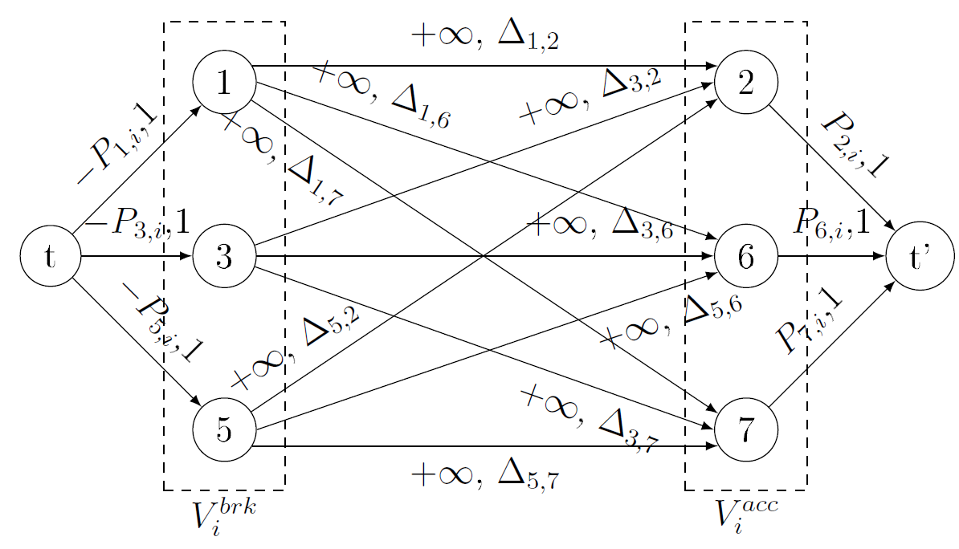
Power flow model
Braking
Trains
Accelerating
Trains

Slide 24
Power flow model
Metro 1 is braking, regenerating a power $P_{1}$
Braking
Trains
Accelerating
Trains

Slide 25
Power flow model
It transfers its power to Metro 6.
The power transferred is $P_{1}.Δ_{1,6}<P_{6}$
Braking
Trains
Accelerating
Trains

Slide 26
Power flow model
Continue with all braking metros until $P_{6}$ demand is fulfilled or all braking metros transfer their energy
Braking
Trains
Accelerating
Trains

Slide 27
The objective function G
Bottleneck of the optimization
Arithmetic sum of the instant power demands computed with the power flow at each time interval
$P_{20}$: instant power demand of time step 20
$$G=\sum_{i}^{Time steps}{P_{i}}$$
0 15 30 45 60 75 90 105 120 135 150 165 180 195 210 225 240 255 270 285 300 315

Slide 28
Optimization Methods

Slide 29
Optimization methods
Use of the customer timetable
Modification of the dwell times length by {-3,…,9} seconds.
Slight modification to ensure feasibility.
Time interval of 1s for energy computation.
Covariance Matrix Adaptation Evolution Strategy (CMA-ES) implementation (Hansen, 2006) on a vector of continuous variables.
MILP model based on the maximization of overlapping braking/accelerating phases
Greedy heuristics. Synchronization for all braking phases of the accelerating phase that minimizes the local energy consumption.

Slide 30
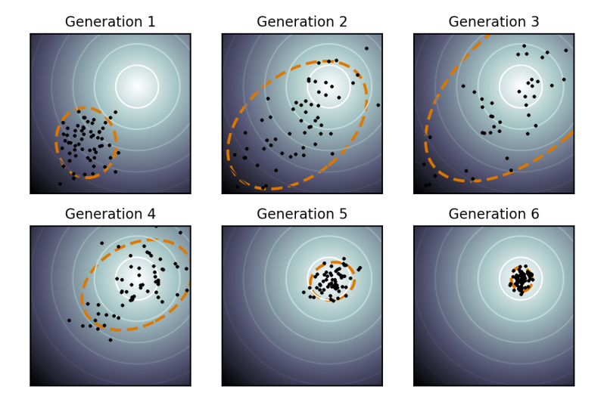
CMA-ES
Evolutionary algorithm for non-linear continuous optimization
New candidates are sampled according to a multivariate normal distribution
Objective function arbitrarily complex.
Quasi parameter-free
Wikipedia

Slide 31
CMA-ES
A candidate solution is a vector of deltas on dwell times $δ_{i}, i∈Dwells$.
Initial point is the original timetable $δ=0$.
Bound handling using a penalty function added to the fitness function
$$p_{i}=\left\{\begin{aligned}{\left(1+\left|δ_{i}−LOWER_BOUND\right|\right)}^{4} if{ δ}_{i}<LOWER_BOUND \\ {\left(1+\left|δ_{i}−UPPER_BOUND\right|\right)}^{4} if{ δ}_{i}>UPPER_BOUND \\ 0 otherwise\end{aligned}\right.$$
Before computing the fitness function, vector of deltas is discretized by rounding float numbers to their closest integer.

Slide 32
MILP
Mixed Integer Linear Programming
Widely used and studied in OR
CPLEX as a very powerful solver
Need to linearize all equations

Slide 33
MILP Linearization
One braking phase can transfer its energy to at most one acceleration phase
One acceleration phase can benefit from at most one braking phase
Each potential transfer is attenuated by a distribution factor
Maximization of the overlapping times between braking and acceleration phases, multiplied by their distribution factor
$$maximize \sum_{t=1}^{M}{\sum_{s=1}^{N}{\sum_{t^{′}=1}^{M}{\sum_{s^{′}=1}^{N}{(O_{t,s,t^{′},s^{′}}.Δ_{t,s,t^{′},s^{′}})}}}}$$

Slide 34
Greedy Heuristics
Shift acceleration phases to synchronize with braking phases
Shifting acceleration phases are equivalent to modify dwell times
Improvements computed with electric-based equations
Notes:
Remonter le point 2 sur le transparent précédent

Slide 35
Algorithm
Train 1
B
A
Train 2
A
Train 3
A
Train 4
B
A
Train 5
A
B
time

Slide 36
Algorithm
1. Choose the first active braking interval of the time horizon
Train 1
B
A
Train 2
A
Train 3
A
Train 4
B
A
Train 5
A
B
time

Slide 37
Algorithm
2. Shift neighbour acceleration phases and compute energy savings
3. Shift best neighbour and fix both braking and acceleration phases
Train 1
B
A
Savings maximized
Train 2
A
Train 3
A
Train 4
B
A
Max shift
Train 5
A
B
time

Slide 38
Algorithm
3. Shift best neighbour and fix both braking and acceleration phases
Train 1
B
A
Train 2
A
Train 3
A
Train 4
B
A
Train 5
A
B
time

Slide 39
Algorithm
1. Choose the first active braking interval of the time horizon
Train 1
B
A
Train 2
A
Train 3
A
Train 4
B
A
Train 5
A
B
time

Slide 40
Algorithm
2. Shift neighbour acceleration phases and compute energy savings
3. Shift best neighbour and fix both braking and acceleration phases
Train 1
B
A
Train 2
A
Train 3
A
Train 4
B
A
Savings maximized
Max shift
Train 5
A
B
time

Slide 41
Algorithm
3. Shift best neighbour and fix both braking and acceleration phases
Train 1
B
A
Train 2
A
Train 3
A
Train 4
B
A
Train 5
A
B
time
Notes:
Griser les phases déjà utilisées.

Slide 42
Algorithm example

Slide 43
Results

Slide 44
Benchmark instances
6 small sample timetables
15 minutes or 60 minutes
Peak or off-peak hour
31 stations, 15~30 metros
Available at http://lifeware.inria.fr/wiki/COR14/Bench

Slide 45
CMA-ES vs. Heuristics
The greedy heuristics outperforms CMA-ES in terms of computation time and objective function on 5 of the 6 benchmark instances
CMA-ES : Covariance Matrix Adaptation Evolution Strategy, Hansen 2006
Notes:
« Generic » for CMAES

Slide 46
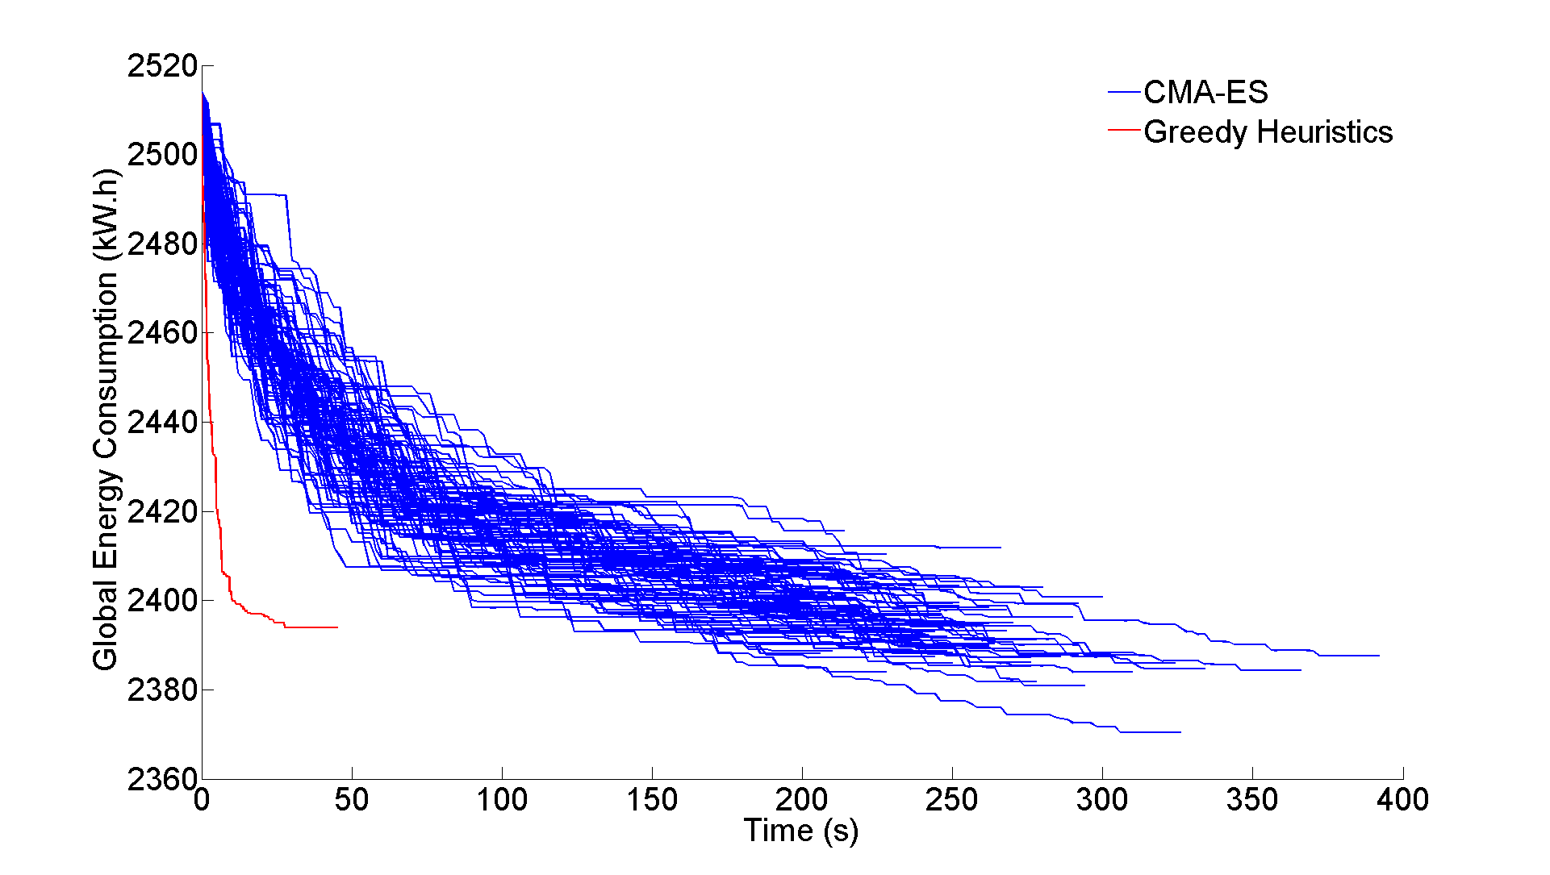
CMA-ES vs. Heuristics
Notes:
« Generic » for CMAES

Slide 47
MILP linear objective
On 4 instances, CPLEX finds the optimum.
On all 6 instances, CPLEX outperforms the greedy heuristics, on the overlapping times objective function
Notes:
« Generic » for CMAES

Slide 48
MILP vs. Heuristics
But comparing the real objective function, the heuristics does better on 5 instances.
Notes:
« Generic » for CMAES

Slide 49
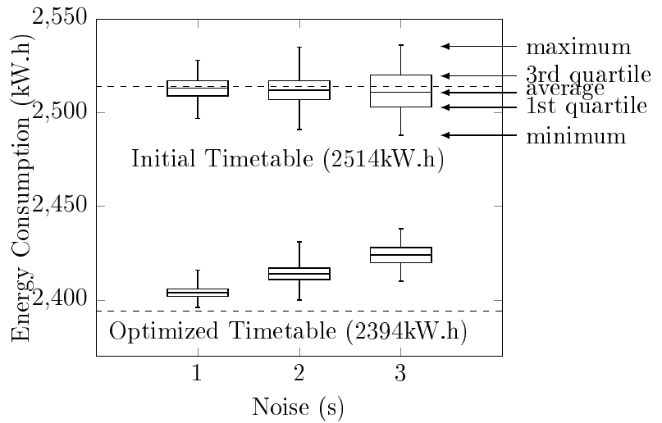
Robustness
Adding noise on variables show that output solutions still save energy even with 3 seconds noises
Notes:
« Generic » for CMAES

Slide 50
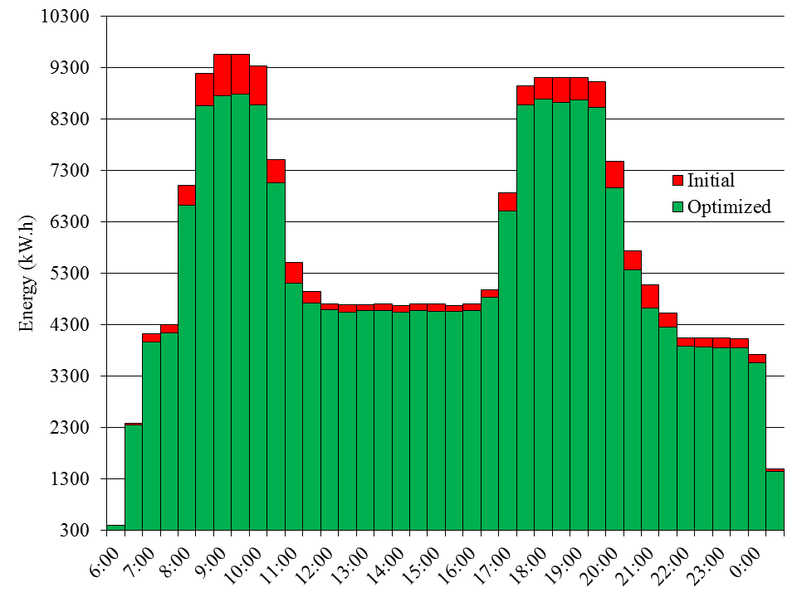
Full Timetable
Highest gains
on peak hours
5.1 % savings
Notes:
« Generic » for CMAES

Slide 51
Take Home Messages
Classification of timetable energy optimization problems
Fast and accurate evaluation of the timetable energy consumption
Greedy dedicated heuristic fast and effective for offline and online optimization
Current work on timetable creation from scratch

